Slide 1
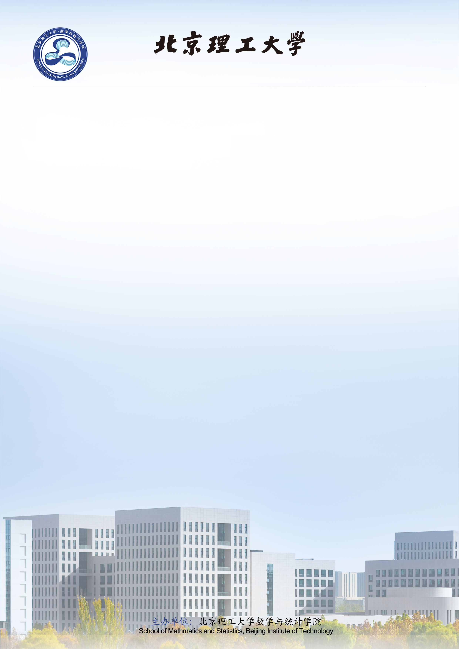
数学与统计学院学术报告
Global classical solutions to the 3D quantum compressible Navier-Stokes
equations and Navier-Stokes-Korteweg equations with arbitrarily large initial data
报告人：黄祥娣（中国科学院数学与系统科学研究院）
时 间： 2026年4月15日 15:30--16:30
地 点：良乡校区 文萃楼 D 303-304 会议室
邀请人：边东芬
摘 要：In this talk, we first prove the existence of global classical solutions to the 3D compressible quantum Navier-Stokes equations for general initial data. This result marks the first proof of global classical solutions with arbitrarily large initial data for a physically meaningful three-dimensional fluid equation in the history of compressible fluid mechanics. In order to achieve that, we develop a new Nash-Moser iteration method to derive the upper and lower bound of the density, which is expected to be widely applicable for improving $L^p$ integrability to $L^\infty$ regularity for general parabolic equations. Building on this observation, we further establish the existence of global classical solutions to the 3D general compressible Navier-Stokes-Korteweg equations with arbitrarily large initial data, thereby resolving a long-standing open problem. The equations were originally proposed by the Dutch mathematician Korteweg in 1901 and later rigorously formulated by Dunn and Serrin in 1985.
个人简介：黄祥娣，中国科学院数学与系统科学研究院研究员，主要从事流体动力学方程的研究，特别是高维可压缩Navier-Stokes方程。他在该领域取得了一系列重要成果，揭示了等熵与非等熵可压缩流体在允许真空初值条件下光滑解的有限时间爆破机制，从而完全解决并推广了诺贝尔奖得主J. Nash于1958年提出的关于可压缩流体光滑解爆破问题的著名猜想。基于这一突破，他首次对等熵与非等熵流体建立了允许真空初值的整体光滑解及弱解理论，进而部分解决了菲尔兹奖得主P. L. Lions提出的关于理想多方气体整体弱解存在性的猜想，其研究成果已在CPAM、CMP、ARMA、Math. An、SIAM J. Math. Anal.等国际权威期刊上发表，并荣获2017年首届及2020年第四届世界华人数学家联盟年会“最佳论文奖”。此外，他于2022年在第九届世界华人数学家大会（ICCM）作一小时大会报告，并受邀在2025年第十届ICCM作特邀报告。

